Slide 1

Chapter 23 – Project planning

Slide 2
Project planning
Project planning involves breaking down the work into parts and assign these to project team members, anticipate problems that might arise and prepare tentative solutions to those problems.
Planning may be necessary with only outline software requirements.
The aim of planning at this stage is to provide information that will be used in setting a price for the system to customers.

Slide 3
Project plans
In a plan-driven development project, a project plan sets out the resources available to the project, the work breakdown and a schedule for carrying out the work.
Plan sections
Introduction
Project organization
Risk analysis
Hardware and software resource requirements
Work breakdown
Project schedule
Monitoring and reporting mechanisms

Slide 4
Project plan supplements
Plan | Description
Quality plan | Describes the quality procedures and standards that will be used in a project.
Validation plan | Describes the approach, resources, and schedule used for system validation.
Configuration management plan | Describes the configuration management procedures and structures to be used.
Maintenance plan | Predicts the maintenance requirements, costs, and effort.
Staff development plan | Describes how the skills and experience of the project team members will be developed.

Slide 5
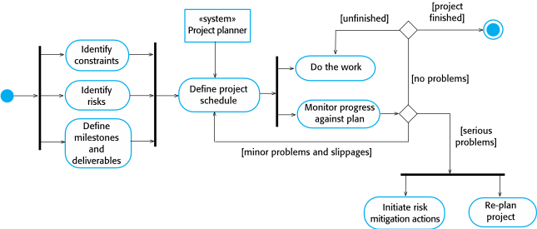
The project planning process

Slide 6
Project scheduling
Project scheduling is the process of deciding how the work in a project will be organized as separate tasks, and when and how these tasks will be executed.
You estimate the calendar time needed to complete each task, the effort required and who will work on the tasks that have been identified.
You also have to estimate the resources needed to complete each task, such as the disk space required on a server, the time required on specialized hardware, such as a simulator, and what the travel budget will be.

Slide 7
Milestones and deliverables
Milestones are points in the schedule against which you can assess progress, for example, the handover of the system for testing.
Deliverables are work products that are delivered to the customer, e.g. a requirements document for the system.

Slide 8
Schedule representation
Graphical notations are normally used to illustrate the project schedule.
These show the project breakdown into tasks. Tasks should not be too small. They should take about a week or two.
Bar charts are the most commonly used representation for project schedules. They show the schedule as activities or resources against time.

Slide 9
Tasks, durations, and dependencies
Task | Effort (person-days) | Duration (days) | Dependencies
T1 | 15 | 10
T2 | 8 | 15
T3 | 20 | 15 | T1 (M1)
T4 | 5 | 10
T5 | 5 | 10 | T2, T4 (M3)
T6 | 10 | 5 | T1, T2 (M4)
T7 | 25 | 20 | T1 (M1)
T8 | 75 | 25 | T4 (M2)
T9 | 10 | 15 | T3, T6 (M5)
T10 | 20 | 15 | T7, T8 (M6)
T11 | 10 | 10 | T9 (M7)
T12 | 20 | 10 | T10, T11 (M8)

Slide 10
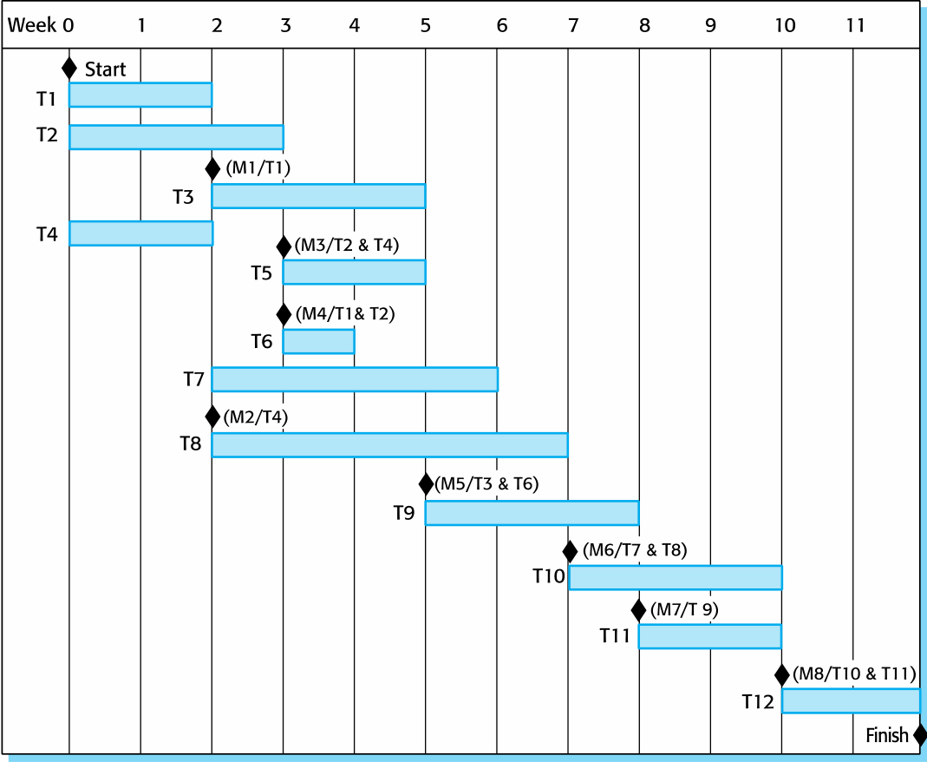
Activity bar chart

Slide 11
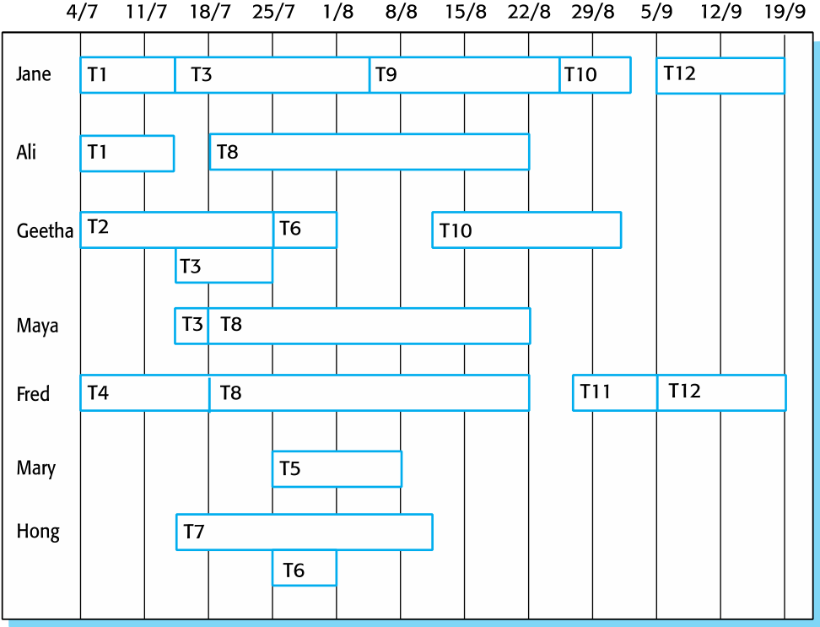
Staff allocation chart

Slide 12
Software pricing
Estimates are made to discover the cost, to the developer, of producing a software system.
You take into account, hardware, software, travel, training and effort costs.
There is not a simple relationship between the development cost and the price charged to the customer.
Broader organisational, economic, political and business considerations influence the price charged.

Slide 13
Estimation techniques
Organizations need to make software effort and cost estimates. There are two types of technique that can be used to do this:
Experience-based techniques The estimate of future effort requirements is based on the manager’s experience of past projects and the application domain. Essentially, the manager makes an informed judgment of what the effort requirements are likely to be.
Algorithmic cost modeling In this approach, a formulaic approach is used to compute the project effort based on estimates of product attributes, such as size, and process characteristics, such as experience of staff involved.

Slide 14
Algorithmic cost modelling
Cost is estimated as a mathematical function of product, project and process attributes whose values are estimated by project managers:
Effort = A × Size^{B} × M
A is an organisation-dependent constant, B reflects the disproportionate effort for large projects and M is a multiplier reflecting product, process and people attributes.
The most commonly used product attribute for cost estimation is code size.
Most models are similar but they use different values for A, B and M.

Slide 15
Estimation accuracy
The size of a software system can only be known accurately when it is finished.
Several factors influence the final size
Use of COTS and components;
Programming language;
Distribution of system.
As the development process progresses then the size estimate becomes more accurate.
The estimates of the factors contributing to B and M are subjective and vary according to the judgment of the estimator.

Slide 16
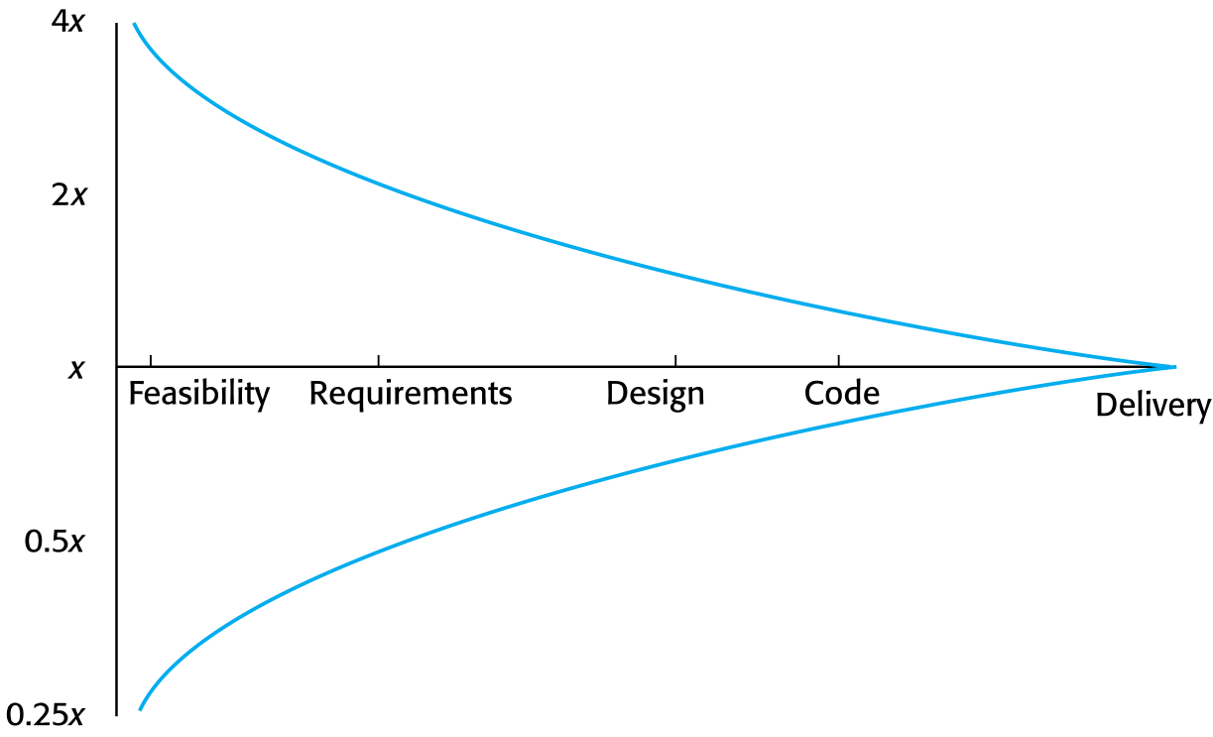
Estimate uncertainty

Slide 17
The COCOMO 2 model
An empirical model based on project experience.
Well-documented, ‘independent’ model which is not tied to a specific software vendor.
Long history from initial version published in 1981 (COCOMO-81) through various instantiations to COCOMO 2.
COCOMO 2 takes into account different approaches to software development, reuse, etc.

Slide 18
COCOMO 2 models
COCOMO 2 incorporates a range of sub-models that produce increasingly detailed software estimates.
The sub-models in COCOMO 2 are:
Application composition model. Used when software is composed from existing parts.
Early design model. Used when requirements are available but design has not yet started.
Reuse model. Used to compute the effort of integrating reusable components.
Post-architecture model. Used once the system architecture has been designed and more information about the system is available.

Slide 19
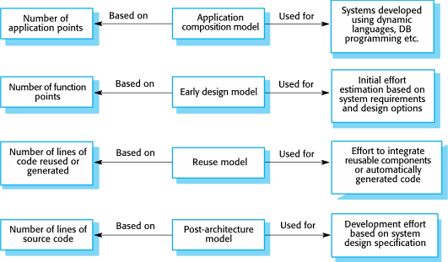
COCOMO estimation models

Slide 20
Application composition model
Supports prototyping projects and projects where there is extensive reuse.
Based on standard estimates of developer productivity in application (object) points/month.
Takes CASE tool use into account.
Formula is
PM = ( NAP × (1 - %reuse/100 ) ) / PROD
PM is the effort in person-months, NAP is the number of application points and PROD is the productivity.

Slide 21
Application-point productivity
Developer’s experience and capability | Very low | Low | Nominal | High | Very high
ICASE maturity and capability | Very low | Low | Nominal | High | Very high
PROD (NAP/month) | 4 | 7 | 13 | 25 | 50

Slide 22
Early design model
Estimates can be made after the requirements have been agreed.
Based on a standard formula for algorithmic models
PM = A × Size^{B} × M where
M = PERS × RCPX × RUSE × PDIF × PREX × FCIL × SCED;
A = 2.94 in initial calibration, Size in KLOC, B varies from 1.1 to 1.24 depending on novelty of the project, development flexibility, risk management approaches and the process maturity.

Slide 23
Multipliers
Multipliers reflect the capability of the developers, the non-functional requirements, the familiarity with the development platform, etc.
RCPX - product reliability and complexity;
RUSE - the reuse required;
PDIF - platform difficulty;
PREX - personnel experience;
PERS - personnel capability;
SCED - required schedule;
FCIL - the team support facilities.

Slide 24
The reuse model
Takes into account black-box code that is reused without change and code that has to be adapted to integrate it with new code.
There are two versions:
Black-box reuse where code is not modified. An effort estimate (PM) is computed.
White-box reuse where code is modified. A size estimate equivalent to the number of lines of new source code is computed. This then adjusts the size estimate for new code.

Slide 25
Reuse model estimates
The formula used to calculate the source code equivalence
ESLOC = ASLOC * (1-AT/100) * AAM.
ESLOC is the equivalence number of lines of new code
ASLOC is the number of lines of generated code
AT is the percentage of code automatically generated.
AAM is the adaptation adjustment multiplier computed from the costs of changing the reused code, the costs of understanding how to integrate the code and the costs of reuse decision making.
Apply the standard formula to calculate total effort
Effort = A × ESLOC^{B} × M

Slide 26
Post-architecture level
Uses the same formula as the early design model but with 17 rather than 7 associated multipliers.
The code size is estimated as:
Number of lines of new code to be developed;
Estimate of equivalent number of lines of new code computed using the reuse model;
An estimate of the number of lines of code that have to be modified according to requirements changes.

Slide 27
The exponent term
This depends on 5 scale factors (see next slide). Their sum/100 is added to 1.01
A company takes on a project in a new domain. The client has not defined the process to be used and has not allowed time for risk analysis. The company has a CMM level 2 rating.
Precedenteness - new project (4)
Development flexibility - no client involvement - Very high (1)
Architecture/risk resolution - No risk analysis - V. Low .(5)
Team cohesion - new team - nominal (3)
Process maturity - some control - nominal (3)
Scale factor is therefore 1.17.

Slide 28
Scale factors used in the exponent computation in the post-architecture model
Scale factor | Explanation
Precedentedness | Reflects the previous experience of the organization with this type of project. Very low means no previous experience; extra-high means that the organization is completely familiar with this application domain.
Development flexibility | Reflects the degree of flexibility in the development process. Very low means a prescribed process is used; extra-high means that the client sets only general goals.
Architecture/risk resolution | Reflects the extent of risk analysis carried out. Very low means little analysis; extra-high means a complete and thorough risk analysis.
Team cohesion | Reflects how well the development team knows each other and work together. Very low means very difficult interactions; extra-high means an integrated and effective team with no communication problems.
Process maturity | Reflects the process maturity of the organization. The computation of this value depends on the CMM Maturity Questionnaire, but an estimate can be achieved by subtracting the CMM process maturity level from 5.

Slide 29
Multipliers
Product attributes
Concerned with required characteristics of the software product being developed.
Computer attributes
Constraints imposed on the software by the hardware platform.
Personnel attributes
Multipliers that take the experience and capabilities of the people working on the project into account.
Project attributes
Concerned with the particular characteristics of the software development project.

Slide 30
The effect of cost drivers on effort estimates
Exponent value | 1.17
System size (including factors for reuse and requirements volatility) | 128,000 DSI
Initial COCOMO estimate without cost drivers | 730 person-months
Reliability | Very high, multiplier = 1.39
Complexity | Very high, multiplier = 1.3
Memory constraint | High, multiplier = 1.21
Tool use | Low, multiplier = 1.12
Schedule | Accelerated, multiplier = 1.29
Adjusted COCOMO estimate | 2,306 person-months

Slide 31
The effect of cost drivers on effort estimates
Exponent value | 1.17
Reliability | Very low, multiplier = 0.75
Complexity | Very low, multiplier = 0.75
Memory constraint | None, multiplier = 1
Tool use | Very high, multiplier = 0.72
Schedule | Normal, multiplier = 1
Adjusted COCOMO estimate | 295 person-months

Slide 32
Project duration and staffing
As well as effort estimation, managers must estimate the calendar time required to complete a project and when staff will be required.
Calendar time can be estimated using a COCOMO 2 formula
TDEV = 3 × (PM)^{(0.33+0.2*(B-1.01))}
PM is the effort computation and B is the exponent computed as discussed above (B is 1 for the early prototyping model). This computation predicts the nominal schedule for the project.
The time required is independent of the number of people working on the project.

Slide 33
Key points
The price charged for a system does not just depend on its estimated development costs; it may be adjusted depending on the market and organizational priorities.
Plan-driven development is organized around a complete project plan that defines the project activities, the planned effort, the activity schedule and who is responsible for each activity.
Project scheduling involves the creation of graphical representations the project plan. Bar chartsshow the activity duration and staffing timelines, are the most commonly used schedule representations.

Slide 34
Key points
Estimation techniques for software may be experience-based, where managers judge the effort required, or algorithmic, where the effort required is computed from other estimated project parameters.
The COCOMO II costing model is an algorithmic cost model that uses project, product, hardware and personnel attributes as well as product size and complexity attributes to derive a cost estimate.

